Slide 1


RAJIV GANDHI COLLEGE OF ENGINEERING & RESEARCH, NAGPUR Department Of Electrical Engineering
Seminar On
“Improvement of Power Quality using Direct Current Control method of STATCOM”
On Occasion of PQAI
Presented By
1. Pankaj Dhongale 5. Tinkesh Bhanarkar
2. Piyush Ganorkar 6. Toshik Ghormare
3. Sanjyot Ramteke 7. Tushar Giripunje
4. Takshak Raul
Under Guide of
Tripti Rai

Slide 2
Contents
INTRODUCTION
Abstract
Aims
Objectives
LITERATURE REVIEW
WORK DONE
RESULT AND DISCUSSION
CONCLUSION
REFERENCES

Slide 3
Introduction
With the rapid development of industry, the requirements of electric power quality are becoming stricter.
Improvement in the reliability, controllability and rapidity of modern power system has become a urgent problem to be solved.
Reactive power and voltage regulation are the major issues in power system operation.
Power quality mainly deals with,
• Continuity of power supply.
•Quality of the voltage.
Various power quality problems may leads to another
undesirable problems like voltage variations, harmonics, flickers.

Slide 4
So, in order to mitigate this problems, Flexible Alternating Current Transmission System(FACTS) is used to enhance controllability and increase power transfer capability of the network.
Series Devices - SSSC,TCSC
Shunt Devices - STATCOM,SVC
Series-series devices - IPFC,UPFC
Series-shunt devices - HVDC link
So, in order to improve power quality by reducing all such problems STATCOM is used .
In this project, we generally focued on STATCOM and it’s working in transmission line.

Slide 5
Abstract
This paper introduced the working principle of STATCOM, uses the method of direct current control of triangle carrier wave to detect both the harmonic and the basic reactive power.
Used the MATLAB to build the model of STATCOM, The simulation and experimental results verified the feasibility and effectiveness of this method, and good tracking performance, and accurately, fast and steady compensation effect.

Slide 6
Aim
Improvement of Power Quality by Controlling Reactive Power in Electrical Transmission System and also Elimination of Harmonics and flickers by using Direct Current Control of STATCOM.

Slide 7
Objective
The grid connected transmission line system
for power quality improvement by using STATCOM has
the following objectives.
• To maintains Power factor as Unity at the Source end.
• To meet the Reactive Power to Non-Linear Load.
• To eliminate the harmonic contents by using STATCOM .

Slide 8
Literature Survey
The Direct Current Control Method Of STATCOM And It’s Simulation.
- Static synchronous compensator (STATCOM) is a central device of modern flexible AC transmission system compared with the traditional reactive power compensation device. STATCOM has a advantages of fast response, absorb reactive continuous harmonic current, low loss, small size etc. STATCOM has become an important development direction of reactive power and harmonic compensation.
Using STATCOM Interfacing Of Renewable Energy Source To Grid And Power Quality Improvement.
- We use novel idea using Facts devices and interface source to grid propose system Facts device use as STATCOM.

Slide 9
Improvement of Voltage Quality in AC Network by use of STATCOM -2005Mazurov M.I., Nikolaev A.V., Lozinova N.G.
- As the STATCOM control by PWM controls current of the phase reactor, the problem of compensation of high harmonic by use of STATCOM can be solve by forming the current containing compensatory components of high harmonic in phase of reactor and in phase of network transformer.
Application of STATCOM for Harmonic Mitigation and Power Factor Improvement Using Direct Current Control Technique 2017 IEEE.
- It is observed that this method is complex in implementation as compared to indirect current control method but due to fast response and precise nature of direct current control method, STATCOM acts as a highly proficient device for power factor improvement and harmonic reduction.

Slide 10
Existing System

Slide 11
Propose Work
UT
Circuit Diagram
Coupling
Transformer
Iq
U
Voltage
Source
Converter
Controller
Udc
Idc
DC Energy Source
Cdc

Slide 12
Study Of FATCS Devices, Loads and their Effect.
Why STATCOM?
Design Of Un-Compensated System
Study Of STATCOM
Study Of Un-Compensated System
Design Of STATCOM
Interfacing Of STATCOM
Study Of Compensated System
Analysis/Comparison Between Compensated and Un-Compensated System
Conclusion

Slide 13
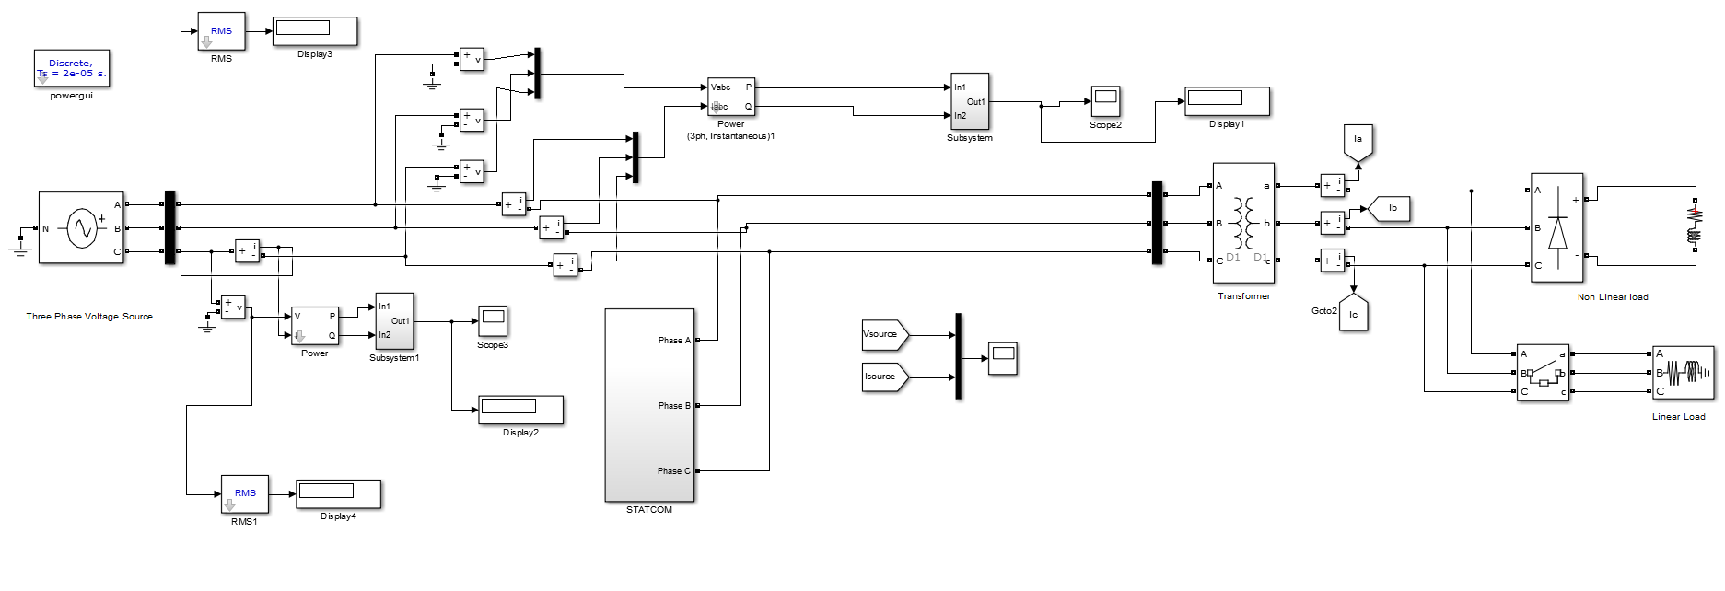
System Diagram/Architecture
Compensated System

Slide 14
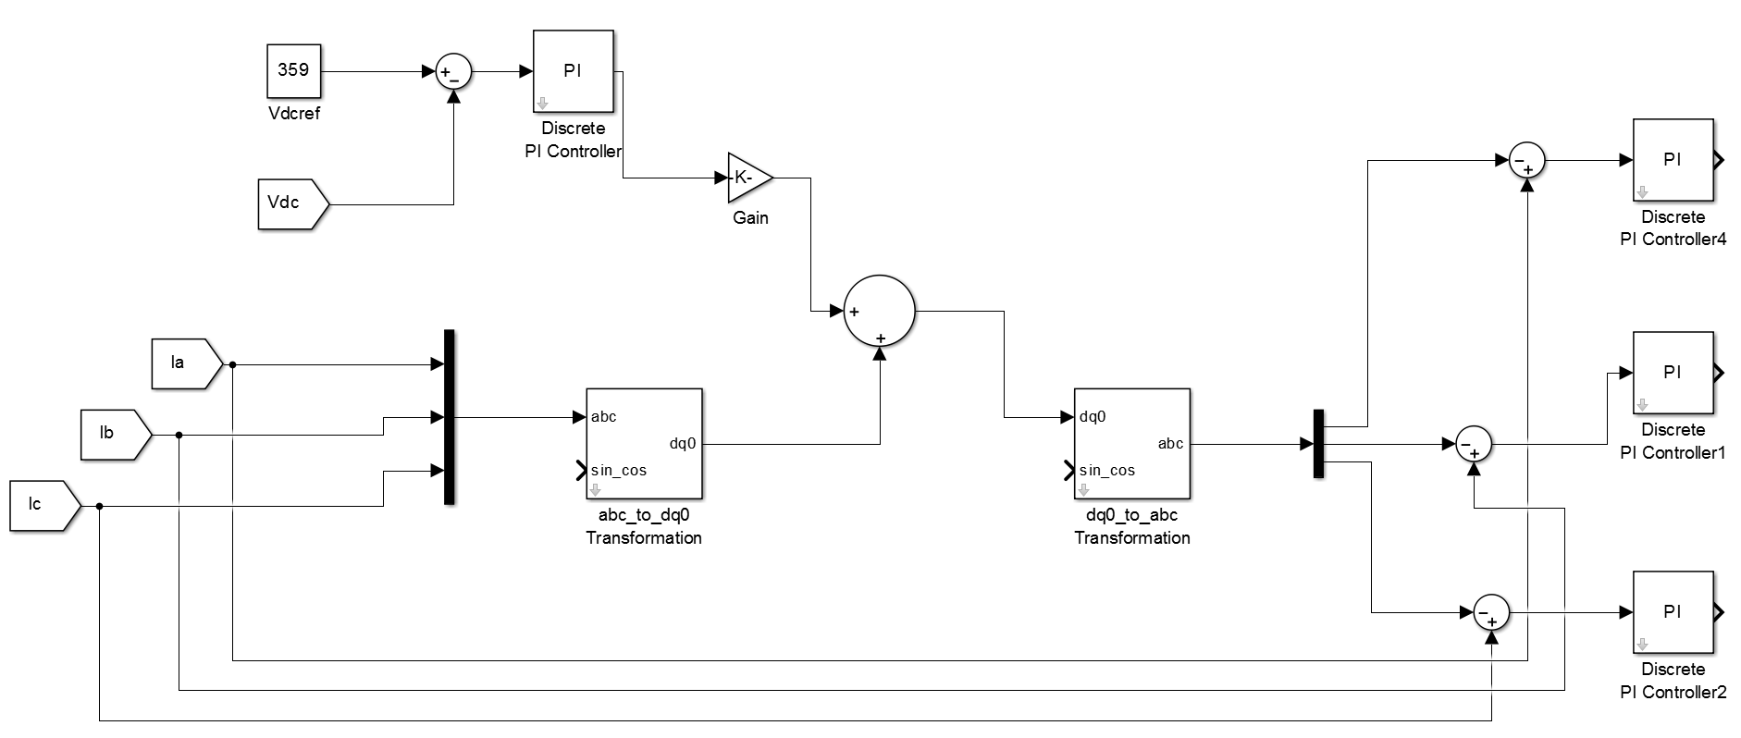
Gate Pulse Generator System

Slide 15
Methodology
This project mainly focuses on the Improvement of Power Quality in Transmission Line using STATCOM by using Direct Current Control Method.
We are using triangular carrier waves to Generate Gate Pulse Signal.
Using MATLAB, we simulate the Uncompensated System of the Transmission line with Linear and Non-Linear Load then observe the Voltage, Current, Power and Harmonics of the system.
Then STATCOM is connected between Source and Load (this is Compensated System) and using method we improve the Power Quality of Transmission Line.

Slide 16
Implementations

Slide 17
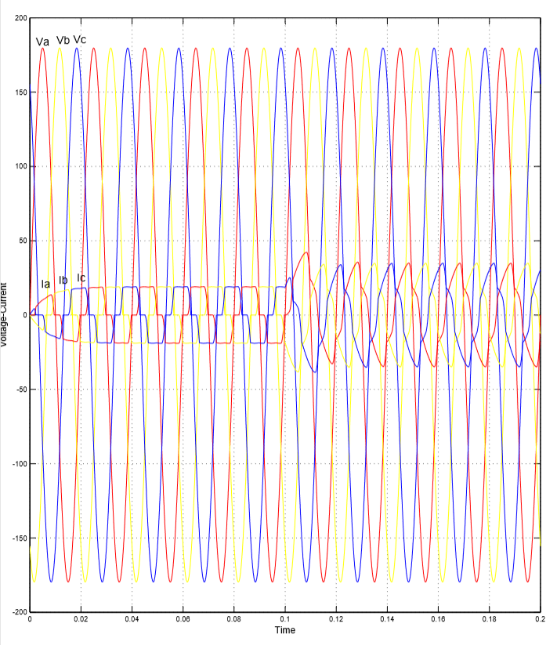
Results
Un-Compensated

Slide 18
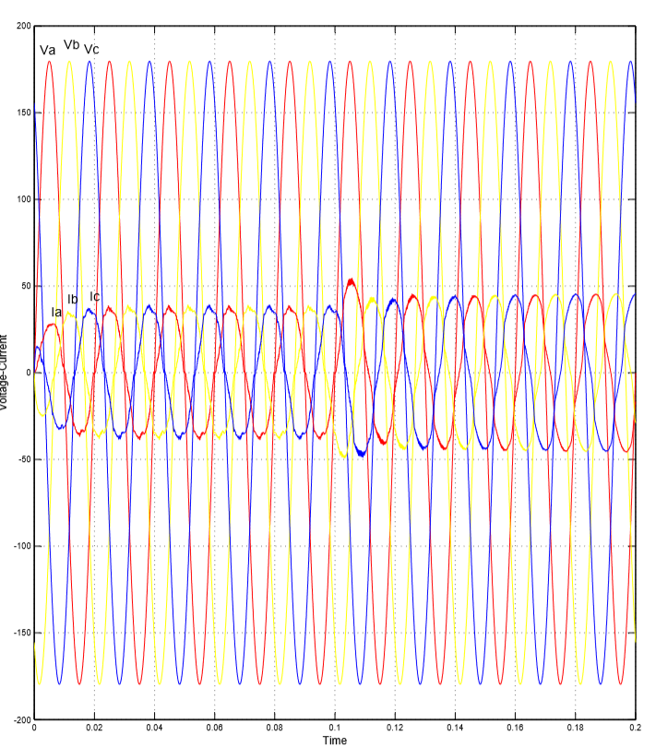
Compensated

Slide 19
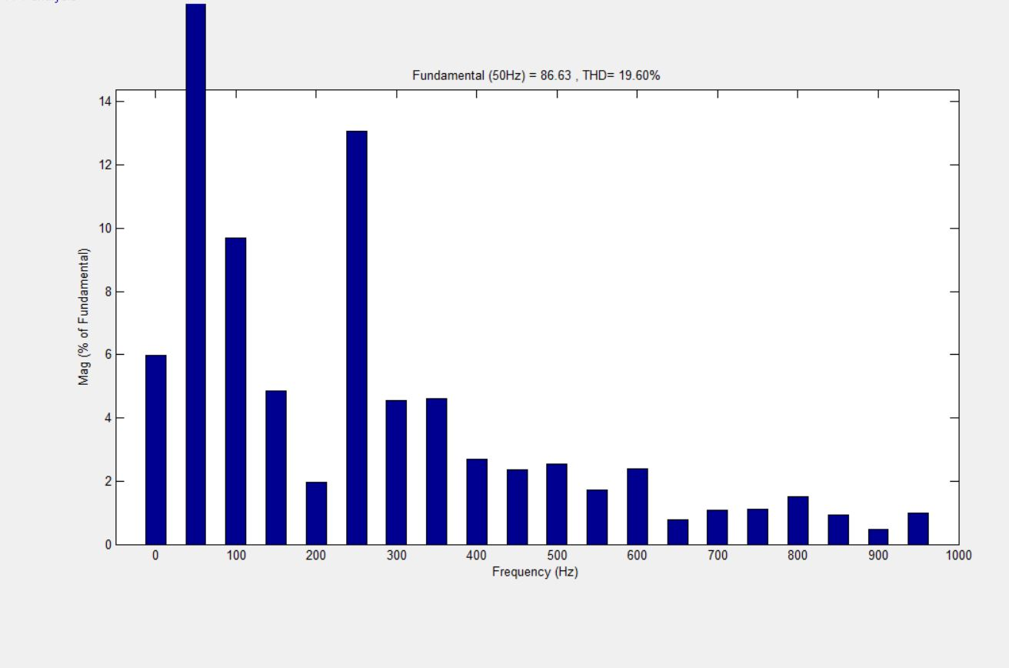
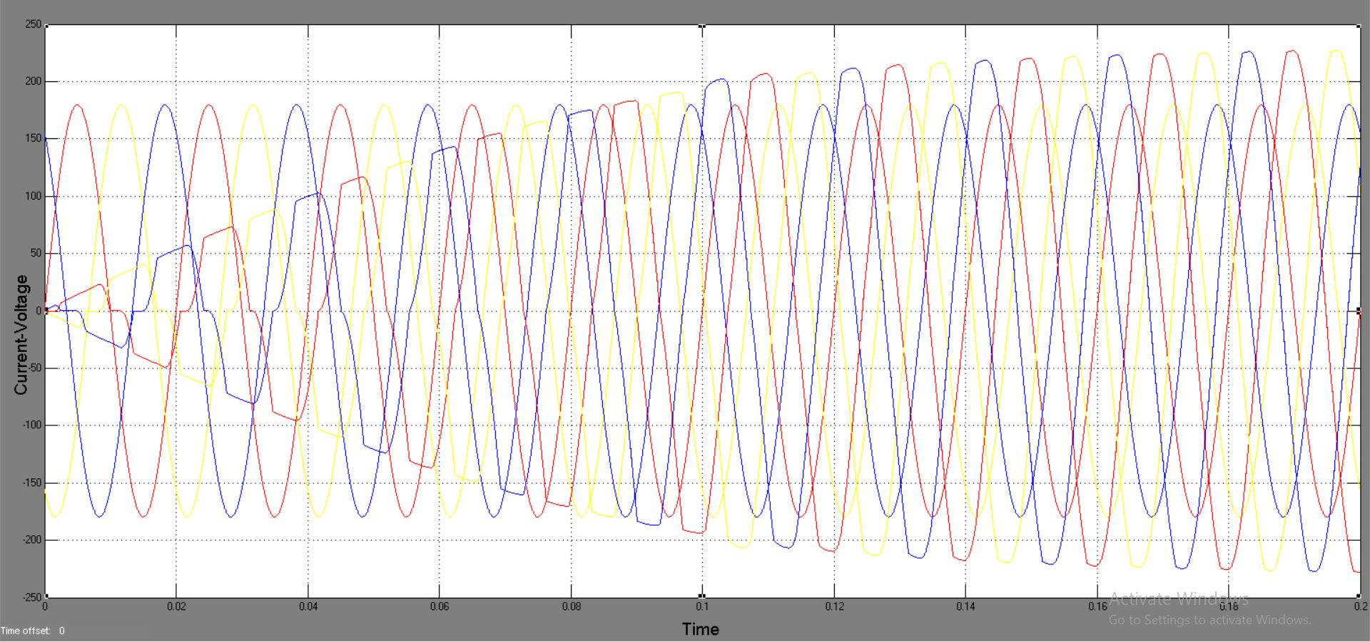
Inductive Load
Un-Compensated System

Slide 20
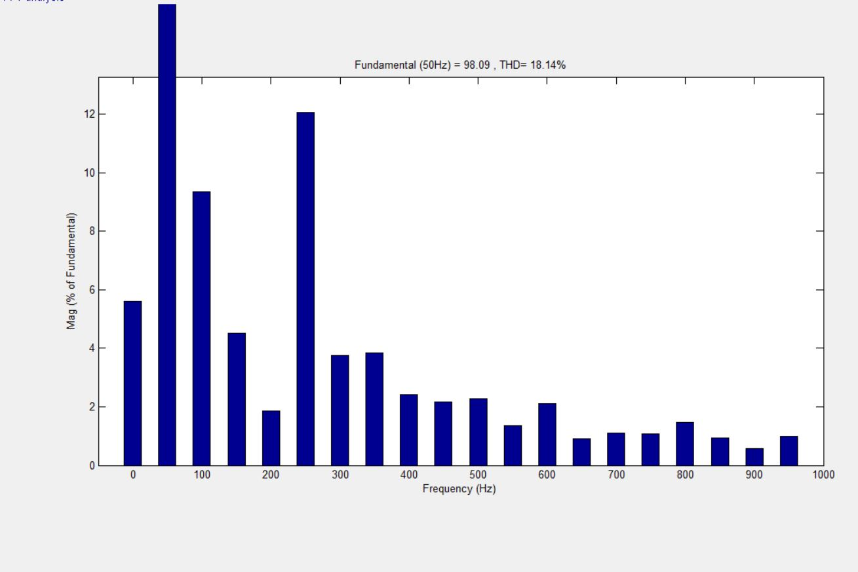
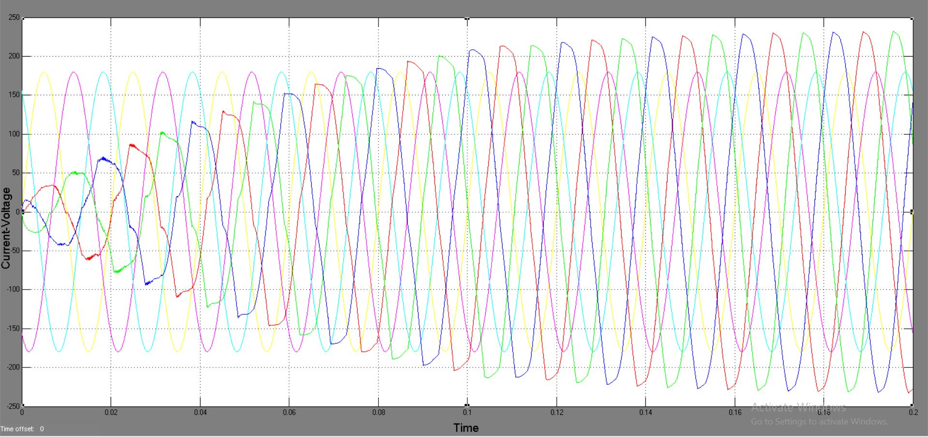
Inductive Load
Compensated System

Slide 21
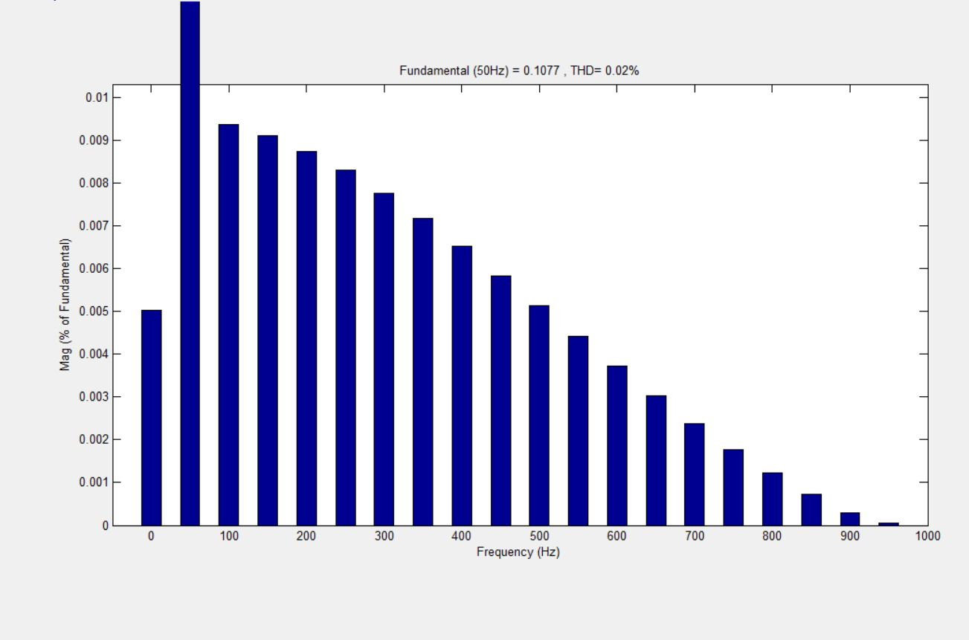
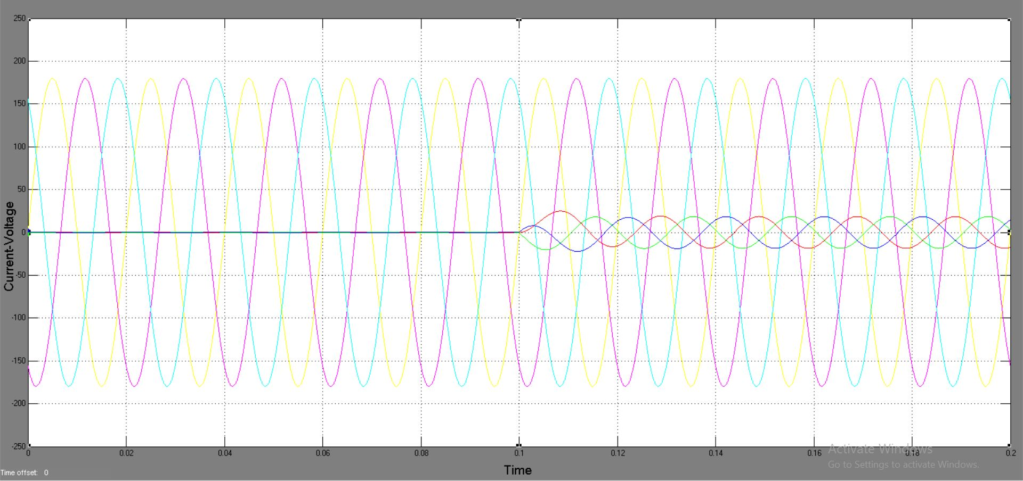
Capacitive Load
Un-Compensated System

Slide 22
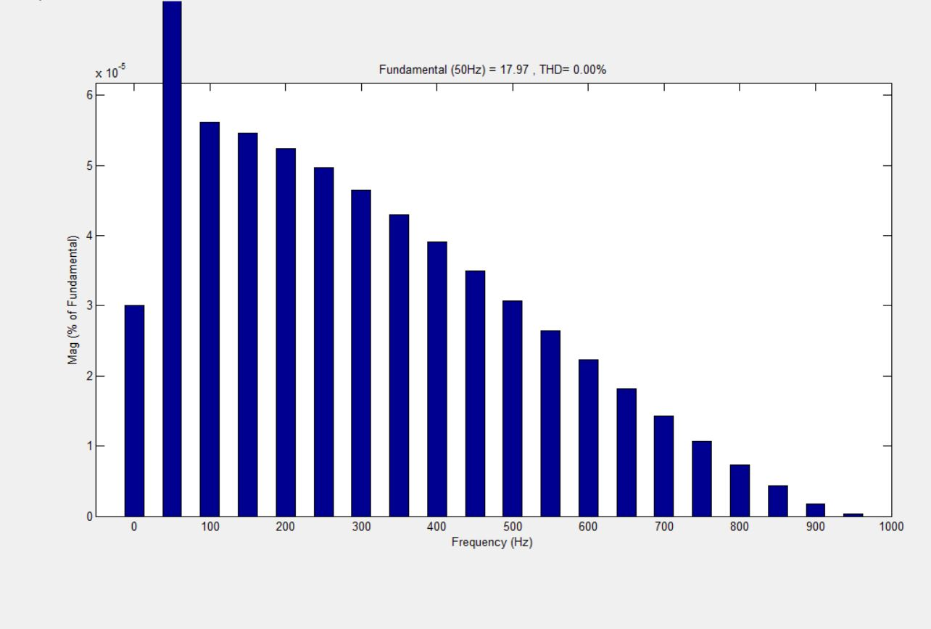
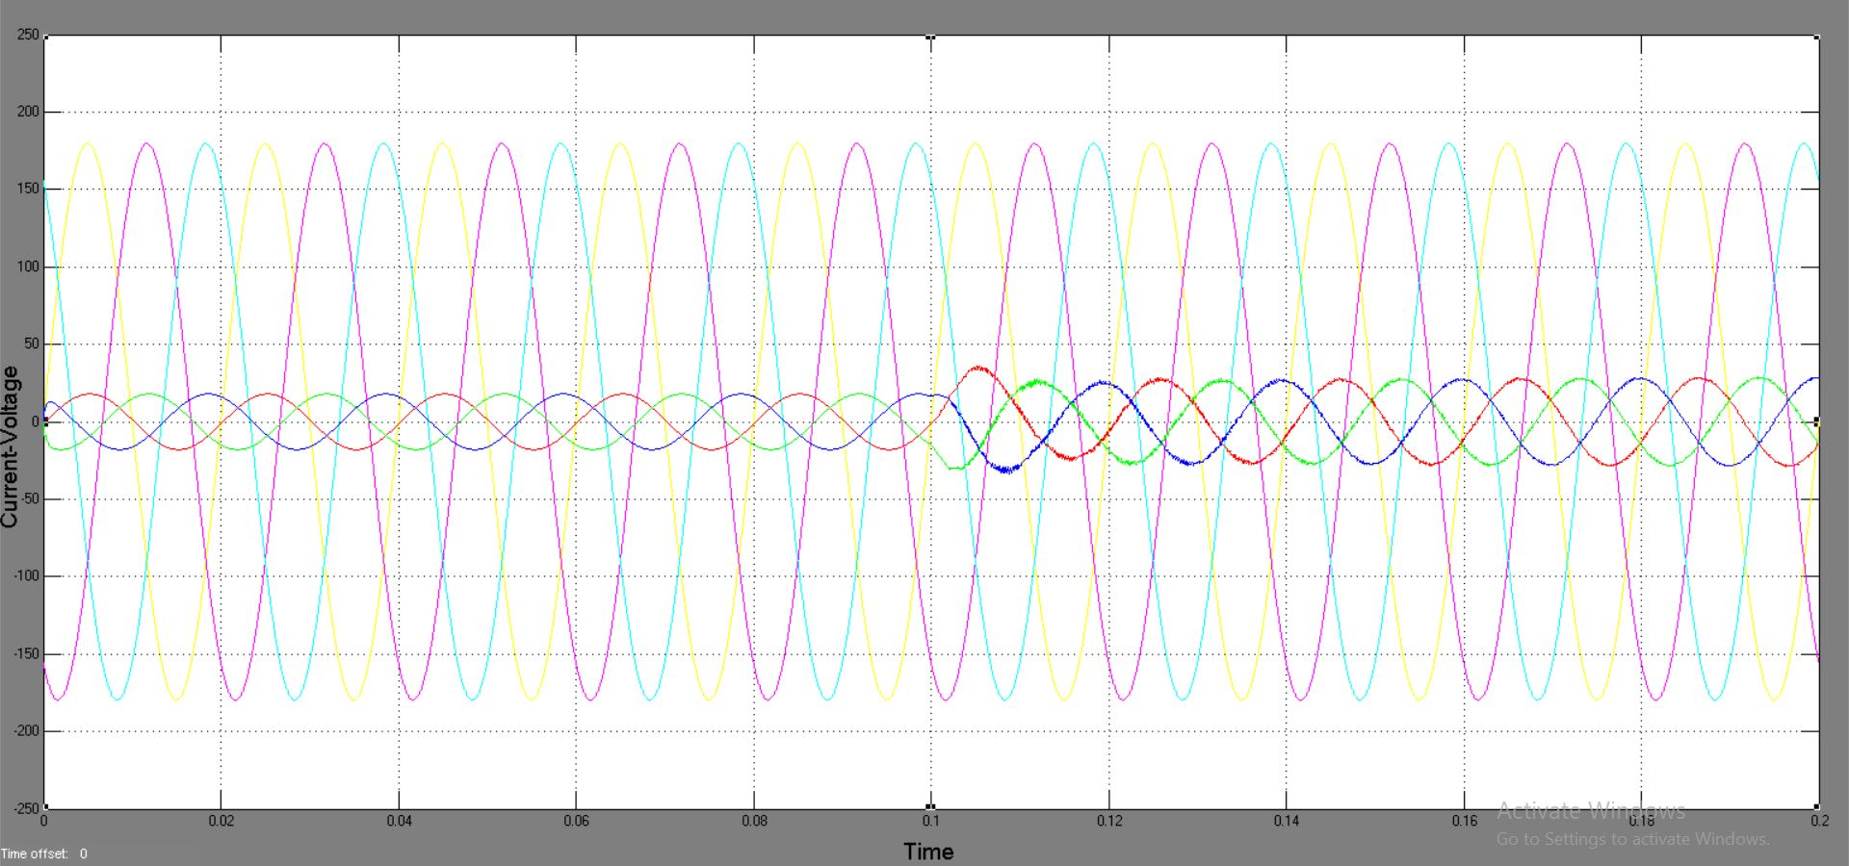
Capacitive Load
Compensated System

Slide 23
References
The Direct Current Control Method of STATCOM and its simulation.2013 Third International Conference on Intelligent System Design and Engineering Applications.
Nagrani G. Hingorani , Laszio Gyugyi. Understanding of FACTS Concepts and Technology of Flexible AC Transmission System . IEEE Press 1999.
Using STATCOM Interfacing of Renewable Energy Sources to Grid and Power Quality Improvement. 2015 International Conference on Energy System and Applications.
P.S. Bhimra , Power Electronics.
Improvement of Voltage Quality in AC Network by use of STATCOM -2005Mazurov M.I.,Nikolaev A.V.,Lozinova N.G

Slide 24
Publication/Presentation
“NEEV 2019” conducted by Department of Civil of Shri Ramdeobaba College of Engineering & Management, Nagpur.
“NCICT 2019” conducted by Department of Computer Science of Rajiv Gandhi College of Engineering & Research, Nagpur.

Slide 25
THANK YOU

